Slide 1
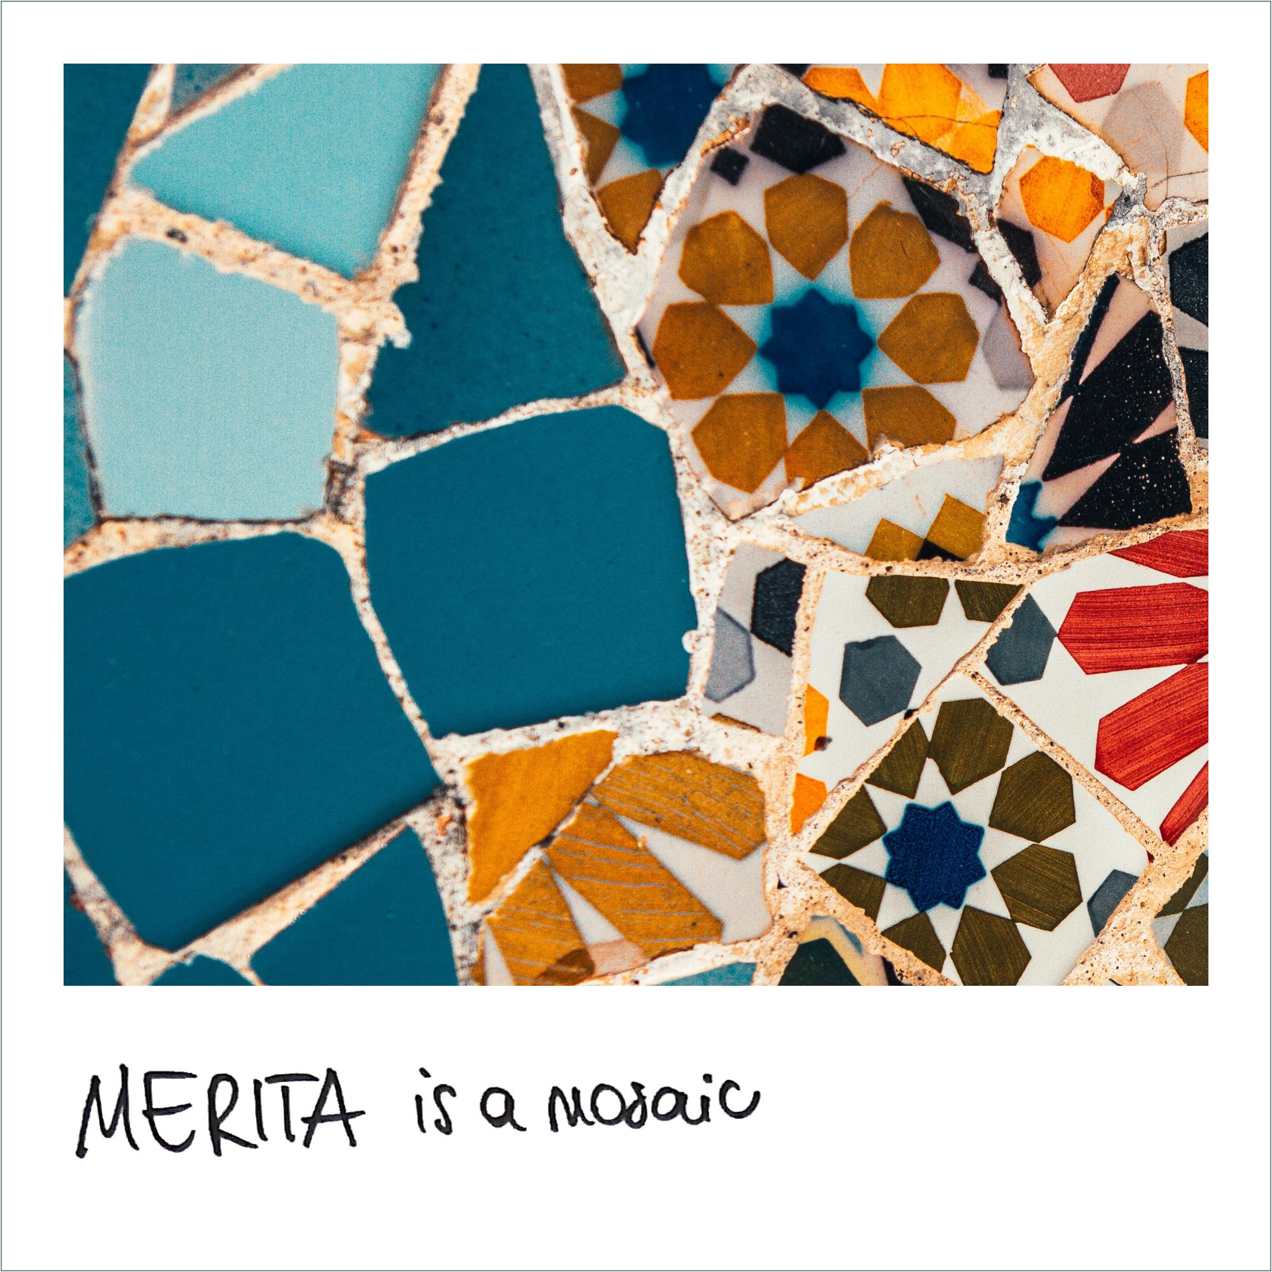
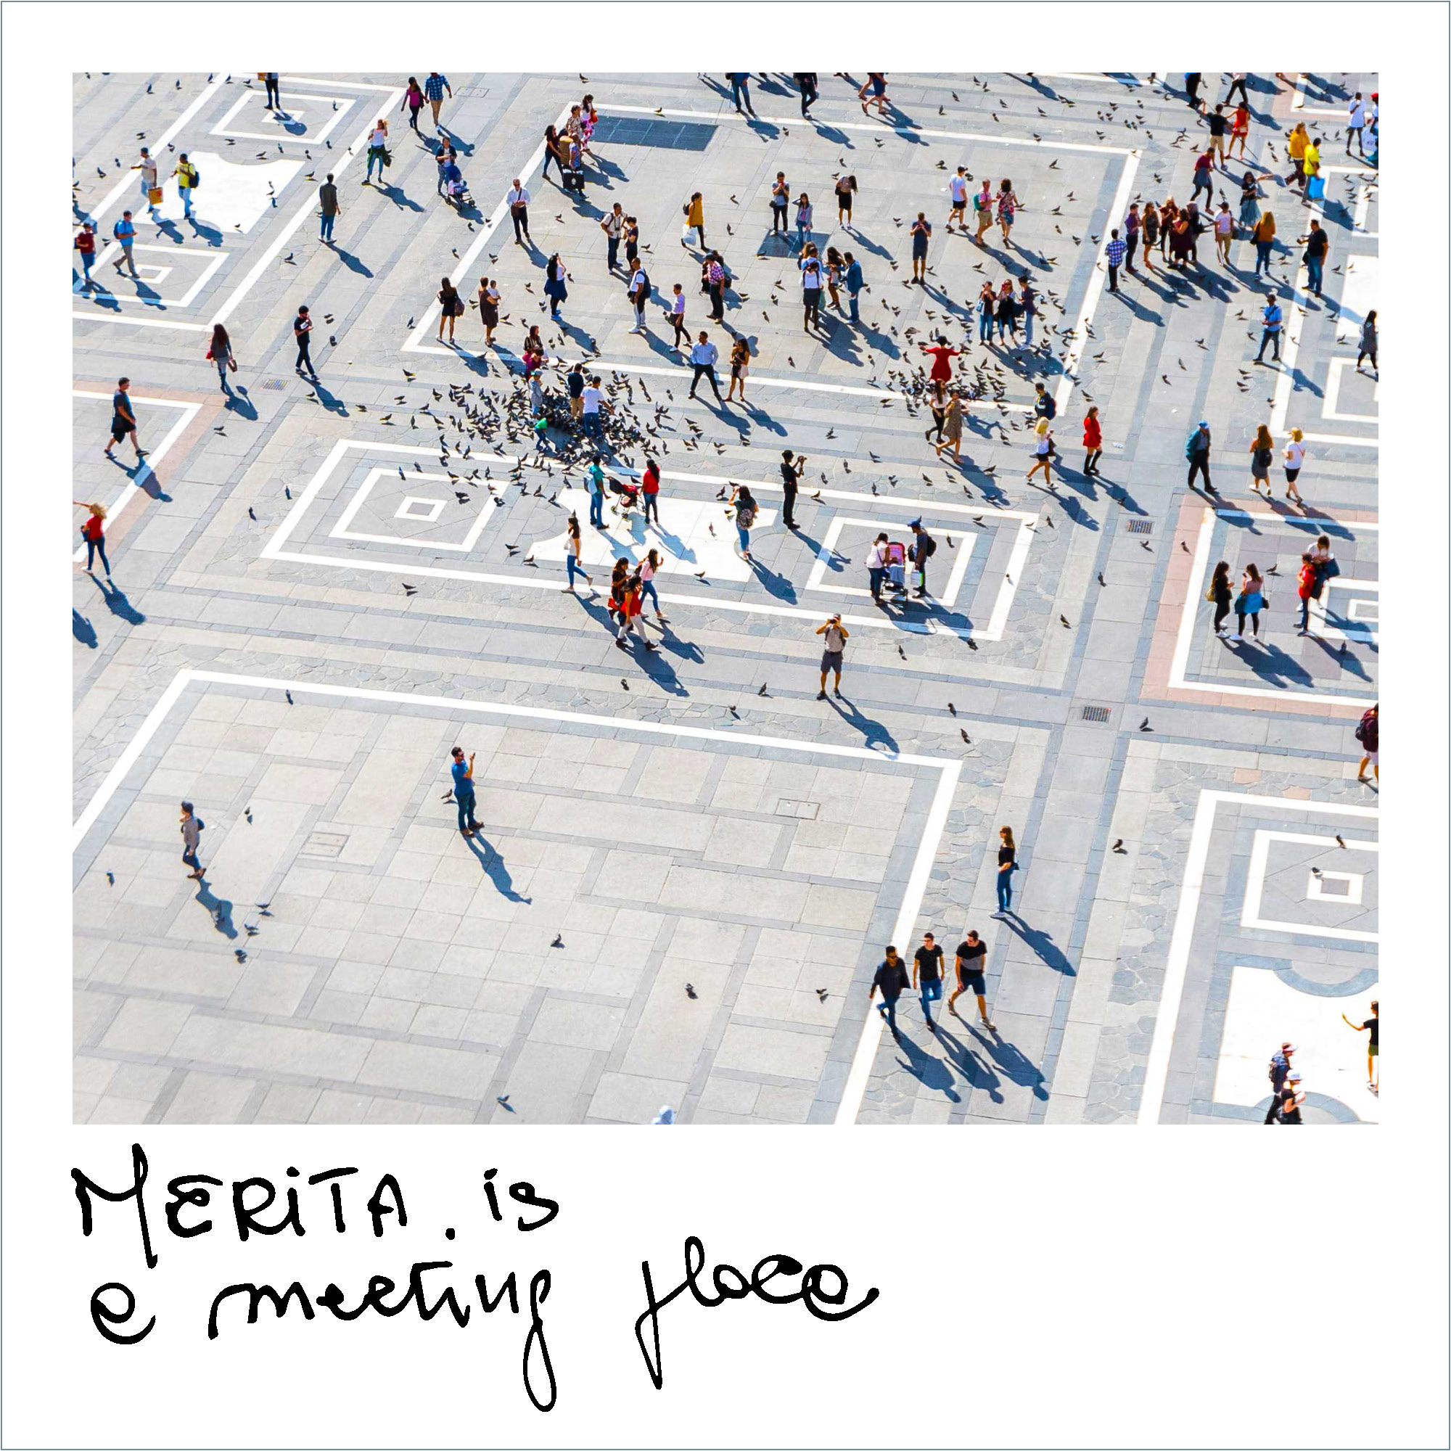
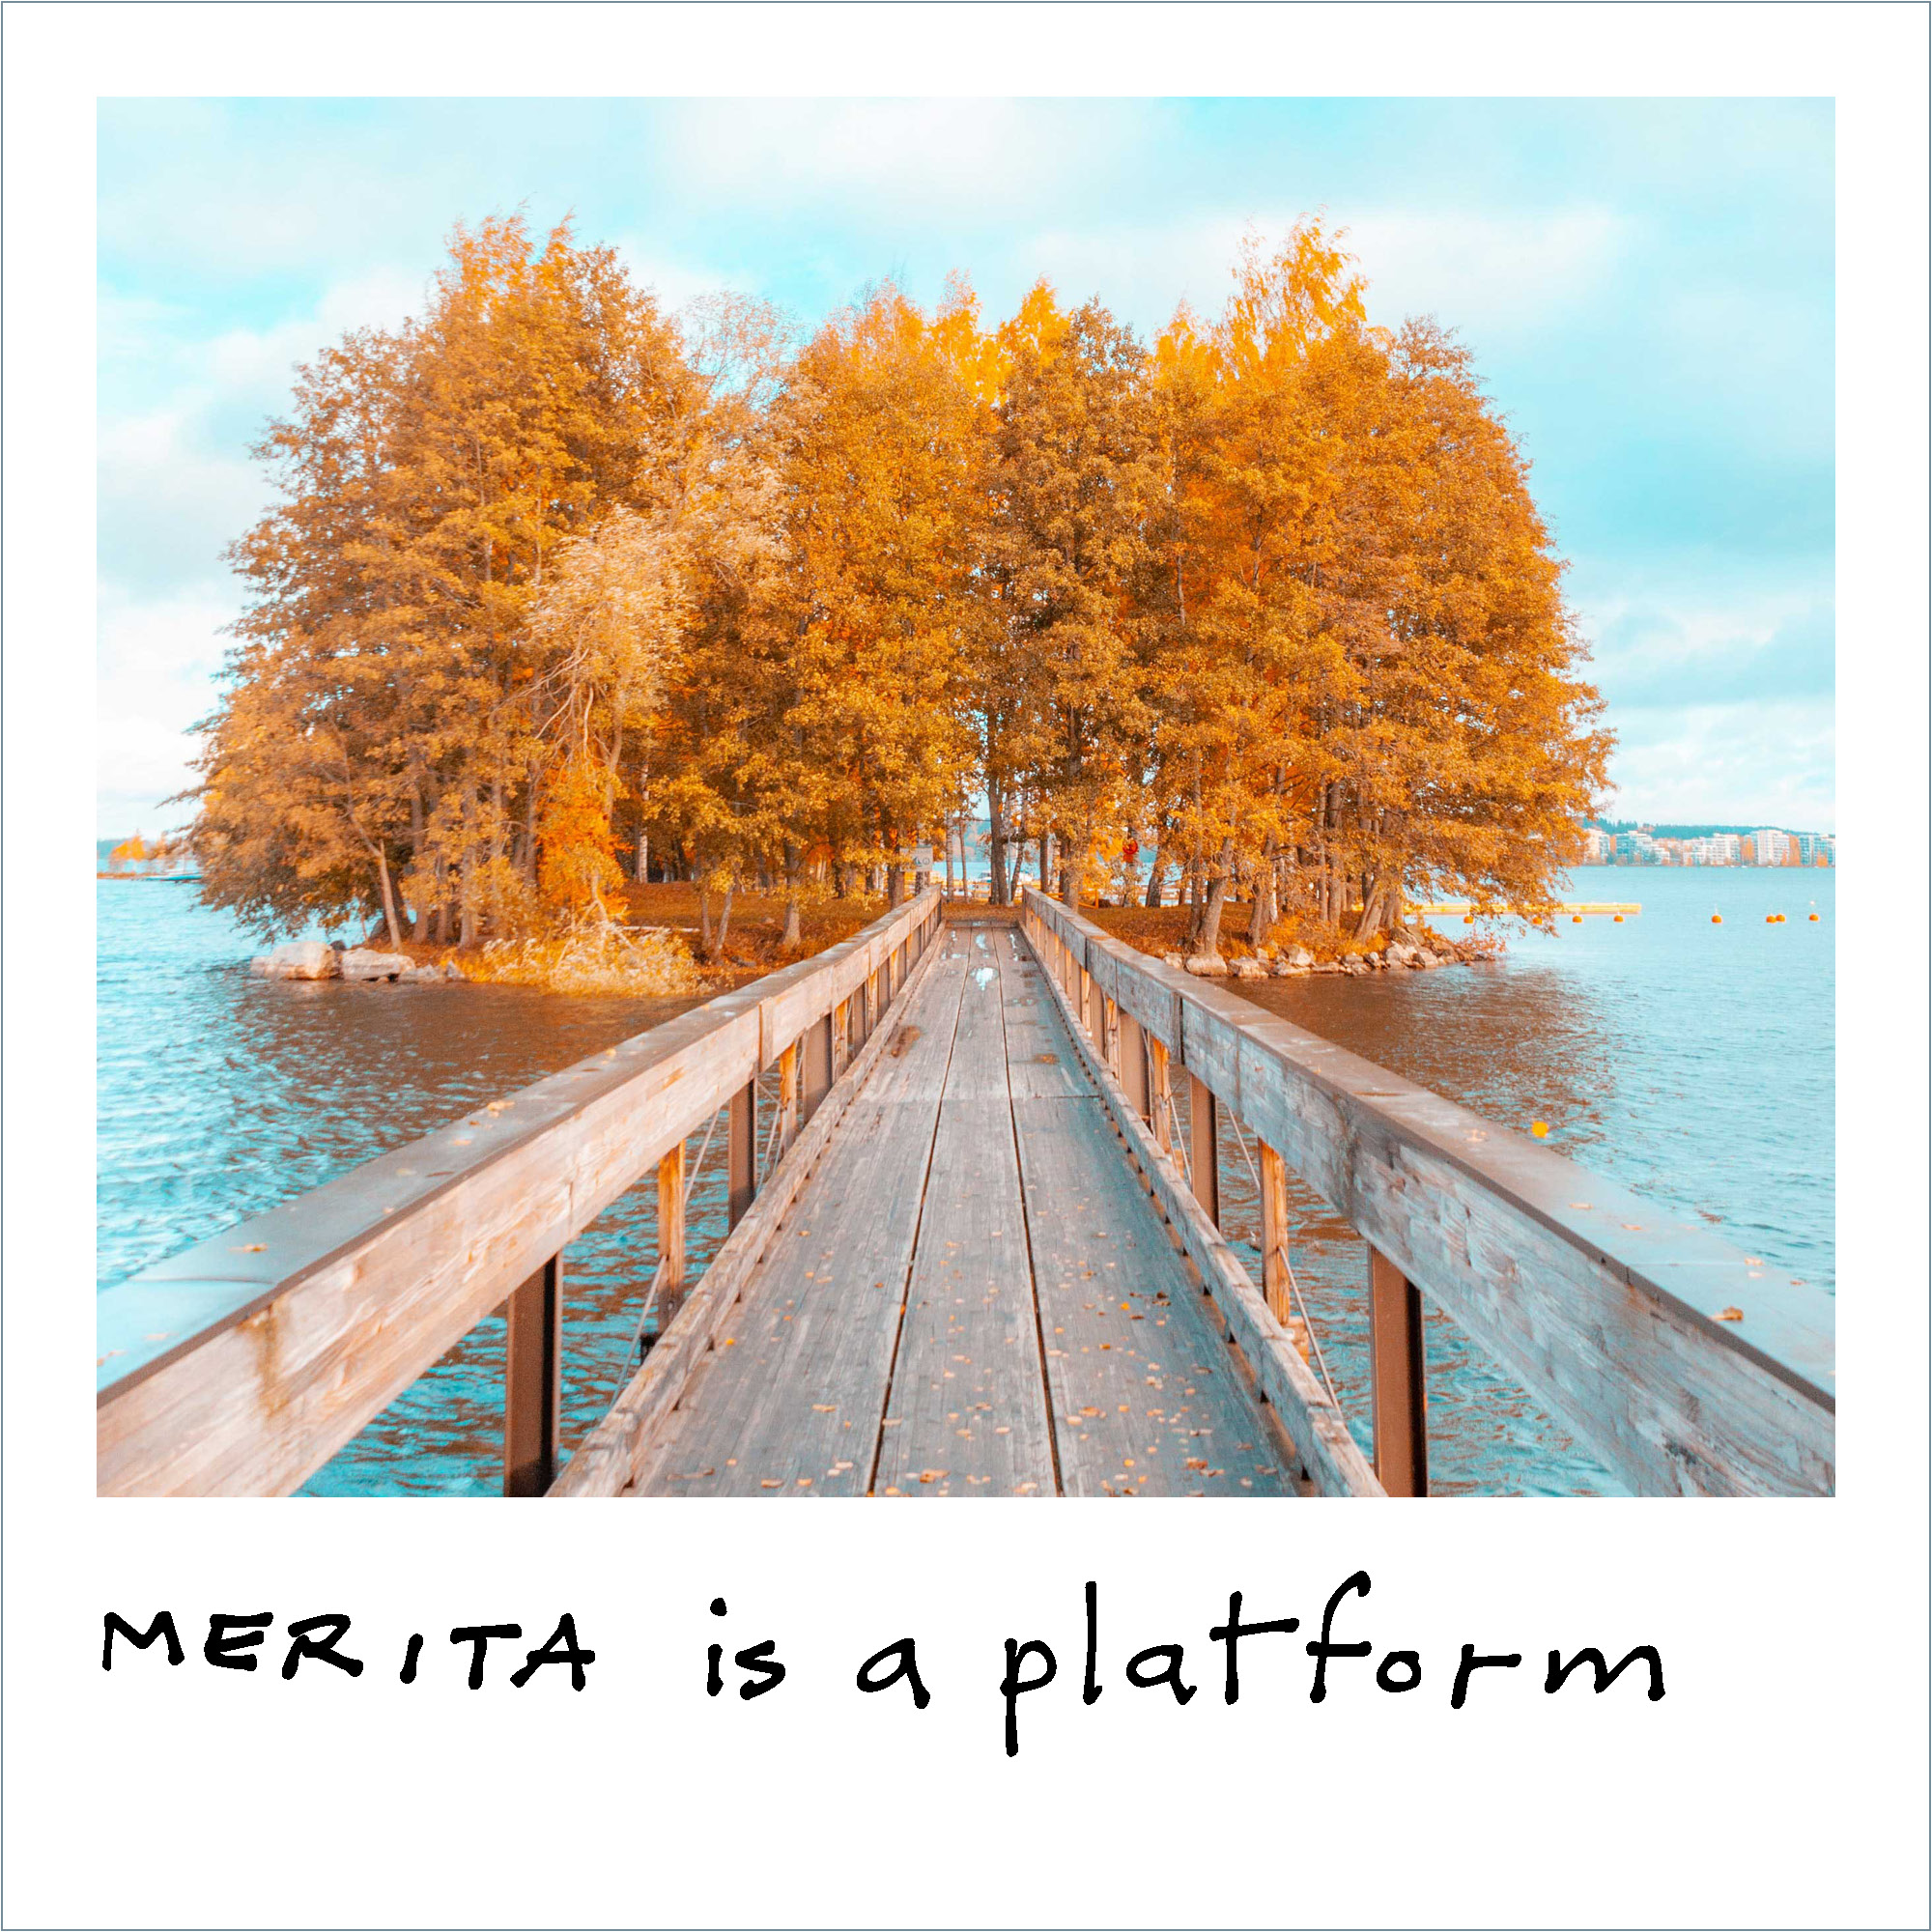
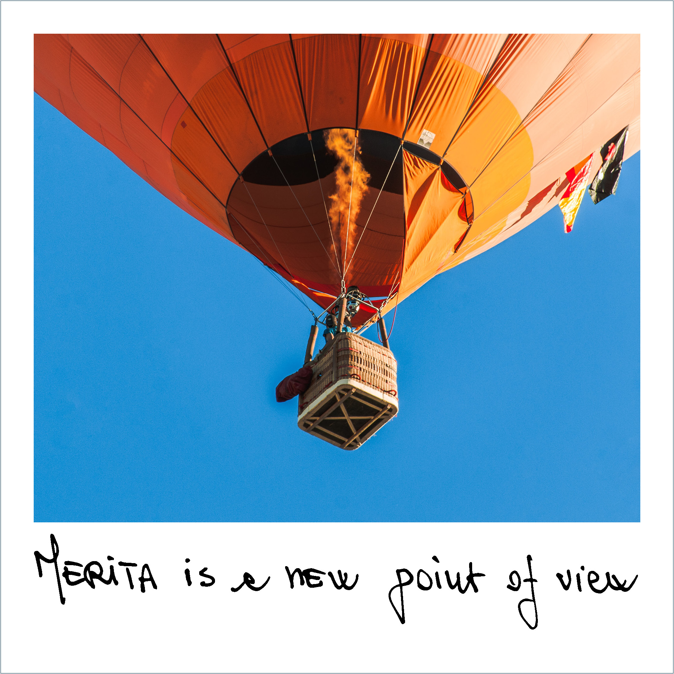
MERITA Platform
Where chamber Music, hERItage and TAlent meet

Slide 2
MERITA PLATFORM | WHAT IT IS
MERITA - where chamber Music, cultural hERItage and TAlent meet is a new European project aimed at increasing the visibility and circulation of 38 emerging European string quartets through a dedicated platform, thus improving the sustainability of the music supply chain, increasing access to and participation in cultural activities and the promotion of European cultural heritage in a circular economy.
Having won the European call Creative Europe - European Platforms 2021, MERITA has obtained co-financing from the European Union.
The project starts in September 2022 and for the period 2022-2025 it involves 17 organizations from 12 European countries, coordinated by Le Dimore del Quartetto as leader, in an innovative programme of sustainable support to young European string quartets and cultural heritage.

Slide 3
MERITA PLATFORM | WHO WE ARE
The consortium is represented by Le Dimore del Quartetto (Italy) as Coordinator of 16 organisations from 12 eligible countries:
Comitato AMUR, Milan (Italy)
European Historic Houses, Brussels (Belgium)
EuAbout Lab ASBL - European Association for Research, Educational, Cultural and Social Innovation, Brussels (Belgium)
ProQuartet – Centre européen de musique de chambre, Paris (France)
Theocharakis Foundation, Athens (Greece)
Stichting Strijkkwartet Biënnale Amsterdam, Amsterdam (The Netherlands)
Europa Nostra, The Hague (The Netherlands)
Traces&Dreams, Stockholm (Sweden)
Lofoten Internasjonale Kammermusikkfest, Oslo (Norway)
University of Arts of Tirana (Albania)
Qendra EVENT, Tirana (Albania)
Julian Cochran Foundation, Warsaw (Poland)
Beogradska Umetnička Nova Teritorija (Belgrade Artistic New Territory), Belgrade (Serbia)
Kolarac - Zadužbina Ilije M. Kolarca, Belgrade (Serbia)
Cadenza Arts Management Ltd., Budapest (Hungary)
Experimenta - Associação para a Promoção do Design e Cultura de Projecto, Lisbon (Portugal)

Slide 4
MERITA PLATFORM | OBJECTIVES
These following objectives will be pursued through the MERITA digital platform as well as through a rich panel of online and onsite activities, i.e. trainings, artistic residencies, transnational and international circulation of the young artists, studies and researches:
Promoting a sustainable business model that unites emerging chamber music artists, audiences, and cultural heritage (European mansions and historic sites), fostering the exchange of best practices and competitiveness for artists, audience engagement and development, and environmental sustainability and awareness.
Promoting the production and diffusion of chamber music in Europe through original outreach projects.
Improving training and development of capabilities of emerging chamber music artists on how to effectively expand, internationalize and consolidate their careers.
Innovating the operation of the chamber music industry by matching the demands of musical institutions with the aptitudes of quartets, thus creating new job opportunities for young musicians.

Slide 5
MERITA PLATFORM | KEY NUMBERS
17 organisations from 12 countries involved
38 quartets involved in the project
7 online trainings available on-demand for the quartets (each quartet chooses a training on a specific topic)
38 on-site trainings / artistic residencies
around 30 European Historic Houses involved
38 innovative projects developed by the quartets
156 concerts: 114 offered by the member concert societies and festivals (3 per participant quartet), 38 “test concerts” performed during the residencies, 4 extra EU concerts
around 135 professional and experts mapped

Slide 6
TO BE A HOUSE PARTICIPATING IN THE MERITA PLATFORM

Slide 7
MERITA PLATFORM | TO BE A HISTORIC HOUSE OF THE MERITA PLATFORM
By joining the MERITA Platform, your House will be part of an international european network enhancing the circulation of the best musical talents at the beginning of their career, and promoting the European cultural heritage.
By hosting on-site residencies, your House will consolidate a new way to live its spaces, increase its visibility and raise awareness of the various possible uses of such heritage sites through an innovative and contemporary cultural formula.
Enhancing the beauty of the territories (even the most remote) the House becomes a cultural landmark for the local community, being able to dialogue with its territory.
Lastly, your House will become an active player in attracting and developing new audiences for classical music.

Slide 8
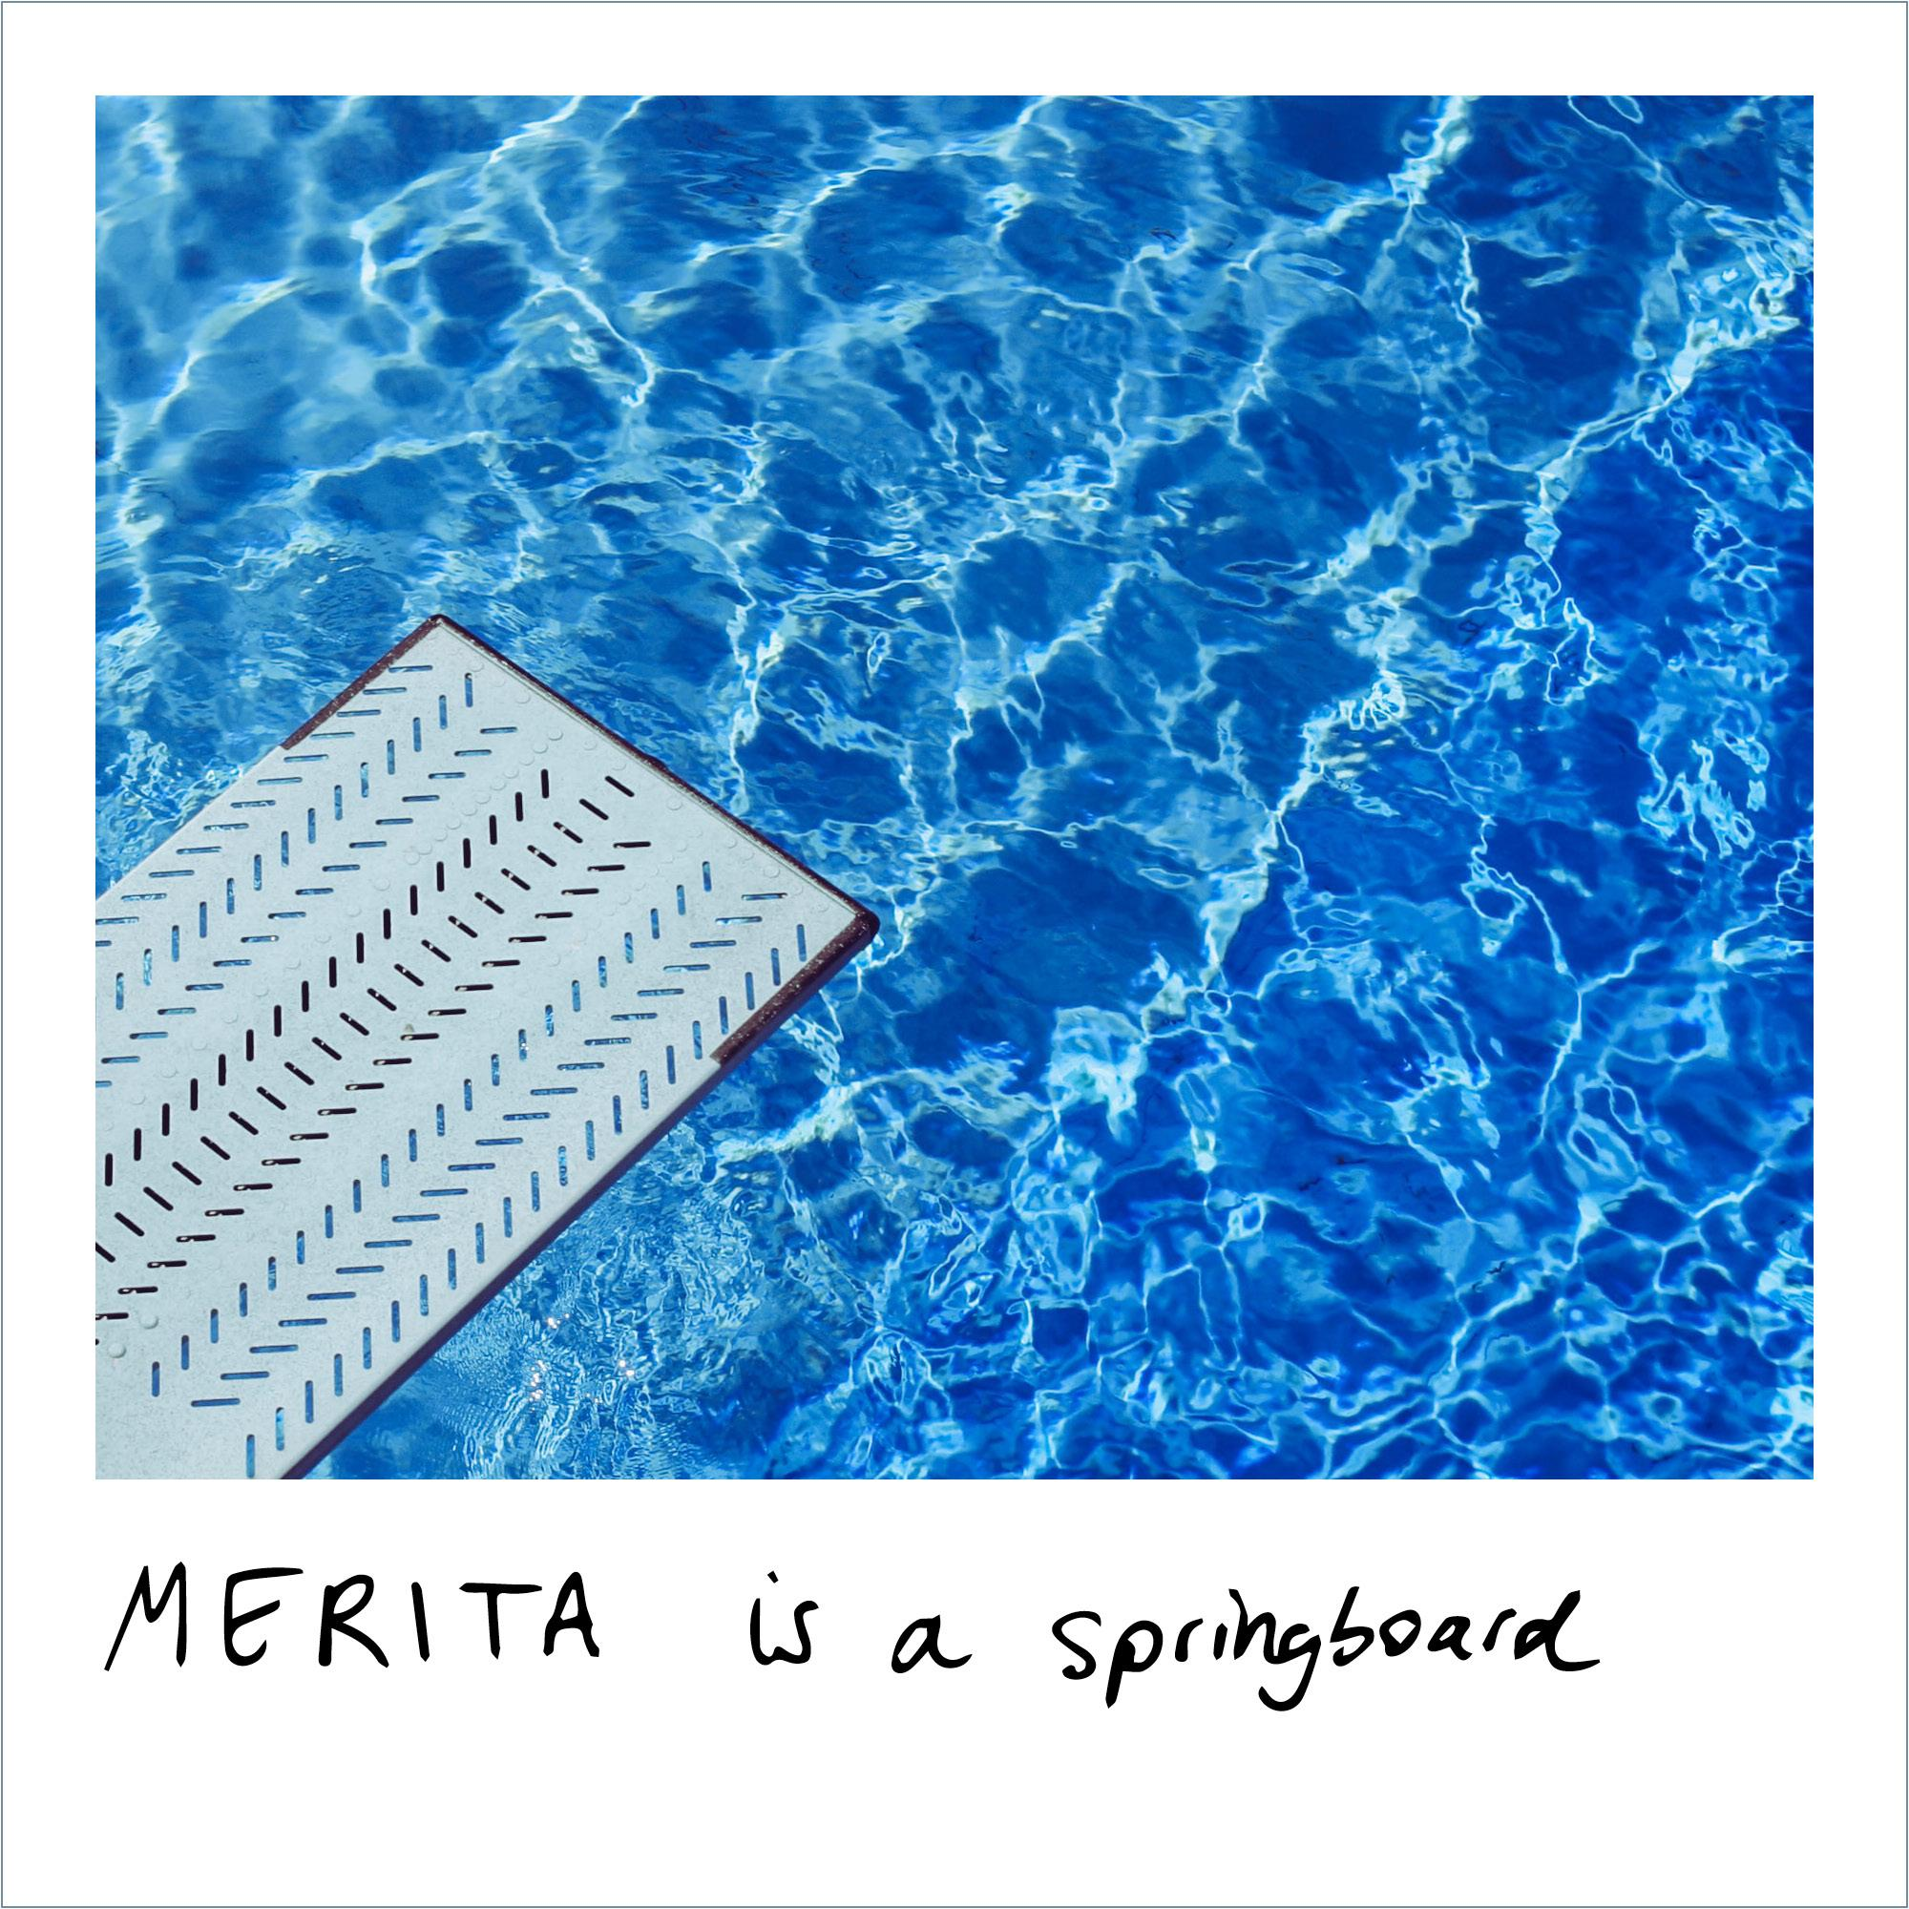
MERITA PLATFORM | BENEFITS
Dedicated page on the digital platform to showcase the venue with insights, curiosities, and history of the soul family of the House;
High-quality concert to assist, and the end of each artistic residences;
Participation in the international network of historic houses, string quartets, chamber music professionals, etc. for the development of the project;
Invitations to public concerts of the network;
Meetings with network owners (in person or online);
Network project advisory;
Involvement in an European research on the entrepreneurial management of historic houses.

Slide 9
MERITA PLATFORM | RESIDENCIES REQUIREMENTS
To participate in the platform:
The House offers to provide the musicians with four beds, a room adequate for rehearsals, and if necessary the access to a kitchen;
The House is willing to host musicians in Artistic Residencies, which are on-site face-to-face training pathways, from September 2023 to April 2024:
The artistic residency lasts 5 days: in this period, the musicians have the opportunity to put into practice the topic program developed during the online training;
During each artistic residency, a trainer from the training member organization will be mentoring the participant musicians. However, the trainer will not be hosted by the House;
The residency ends with a “test” concert, a part of the training programme allowing musicians to put into practice their special projects.
European Historic Houses will be in charge of matching each selected string quartet with the most suitable historic house.
Costs related to the organization of artistic residencies for the MERITA project are covered by European Historic Houses.

Slide 10
OVERVIEW OF THE MERITA PLATFORM

Slide 11
MERITA PLATFORM | TARGETS
European historic houses, scattered all over the European territory, are an integral part of the cultural heritage. They can be private houses, tourist accommodations, farms, museums, foundations; they are all different but share some characteristics such as, availability of wide spaces, beauty, the need to be enhanced and bequeathed to future generations. They are often located in rural areas, where it is difficult to live throughout the year, and are onerous to maintain, restore and heat. Living in a historical house means, first and foremost, keeping it alive. The MERITA Platform involves them by offering high-quality cultural contents for their spaces and gives them the possibility to experiment with new forms of utilisation of these venues.
Cultural venues find an innovative way to experience their spaces, opening up to artists and audiences, in a sustainable model. They increase their visibility and raise awareness of the various possible uses of such heritage sites as well as their assets for the society as a whole (cultural, environmental, economic and societal impact).

Slide 12
MERITA PLATFORM | TARGETS
Emerging string quartets composed by members aged 18 to 35, who play permanently together and has already demonstrated to have all the artistic and technical qualities, as well as the vision, that are necessary to develop an international career.
Music institutions (concert societies and festivals) are cultural centres for the community, planning activities at the service of collective and widespread cultural growth. They have the responsibility of supporting the career of new musicians, of preserving the tradition and the precious legacy of classical music but the need to innovate the proposal and the methods of use.
Audiences The platform aims to attract a variety of different audiences: children and families, disadvantaged communities, young people, older people, corporate people (allowing them to discover music at work), school and university students, and inmates. Moreover, by bringing young musicians to perform in historical spaces in a wide range of locations, many of which are often underserved by the cultural industry, new audiences are enabled to experience classical music. This is correlated with the discovery of local culture and heritage, in a holistic approach which aims to draw together music and history and so foster engagement with both local and European culture.

Slide 13
MERITA PLATFORM | ACTIVITIES, TRAINING AND CAPACITY BUILDING
Aim: supporting the quartets in developing outreach/special projects to be proposed to concert societies and festivals
Online trainings, March - October 2023
7 different topics are defined matching string quartets’ interests, training organisations’ expertise and concerts organisations’ desires
Learning materials are prepared by each training organisations and then edited and uploaded on the platform
On-site trainings (5-day artistic residency + test concert), September 2023 - April 2024
Each quartet benefits from one residency, for a total number of 38 residencies
A tutor mentors the participant musicians during the entire residency
The residency ends with a “test” concert

Slide 14
MERITA PLATFORM | ACTIVITIES, CONCERTS PRODUCTION AND ORGANISATION
After the completion of online and onsite trainings, the presentations of the 38 innovative projects developed by the quartets are uploaded on the platform. Each member concert society and festival can choose its favorite concert proposals, and hire the quartets for performing these concerts in its seasons, festivals or concert series.
From February 2024 to August 2025
Total number of concerts: 114 + 4 extra EU concerts

Slide 15
MERITA PLATFORM | ACTIVITIES, NETWORKING AND RESEARCH
To allow project target groups to meet, exchange and network among themselves, a few networking meeting are organized:
a specific meeting for historic houses owners/managers is organised by European Historic Houses in presence or online, in October 2024.
a meeting for cultural sites managers is organised by Europa Nostra, in presence or online, in March 2025.
One of the aims of MERITA is to develop a sustainable business model for chamber music and cultural heritage, with a long-term perspective. By the end of the project, a report about sustainable business model is created. The report will also contain European Historic Houses’ research on the entrepreneurial management of historic houses, Europa Nostra’s Manifesto, and a report written by Punto3 (subcontractor) on environmental management analysis for cultural venues.

Slide 16
MERITA PLATFORM | THE DIGITAL PLATFORM
The digital Platform is the main area for:
artists showcase;
cultural sites and historic houses presentation;
learning materials;
networking and contents for the audiences;
communication of online and on-site activities, i.e. trainings, artistic residencies, circulation of the young artists, research studies.
The MERITA platform strengthens the connections between local and European culture and between online and offline engagement.

Slide 17
THANK YOU!

